Slide 1
Market Knowledge
Market Tracking Solution Requirements
Step One
November 1st, 2005 (Replay, November 9th, 2005)

Slide 2
Agenda
Process
Roles and Responsibilities
Step One: User Scenarios
Why?
Identifying Scenarios
Teams
Examples / Suggestions

Slide 3
Requirements Process –
Learnings from ISMK
Engineering, Architecture and Operations Involvement / Alignment
Clear Product Scope
  Features based on required Product Capabilities
  Features prioritized
  Capabilities that deliver the core value propositions
  Value Propositions that reinforce the Release Themes
    Broader Coverage
    Greater Flexibility
    Faster Content Replenishment
    More Customization built into the standard product
Requirements
  One size fits all approach did not work in many cases – Use Cases only
  Light on Non-functional requirements
  Heavy on design – Too much “how”, sometimes not enough “what”

Slide 4
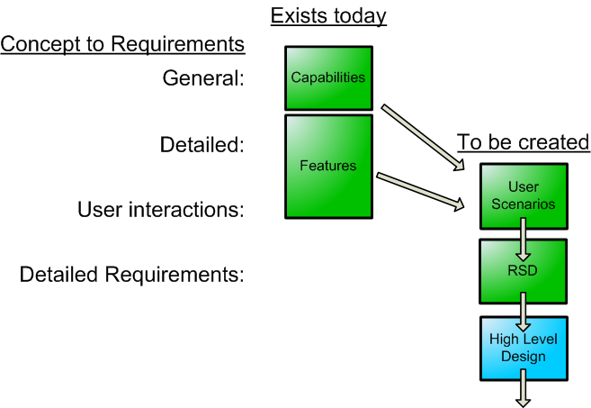
Requirements Development Process

Slide 5
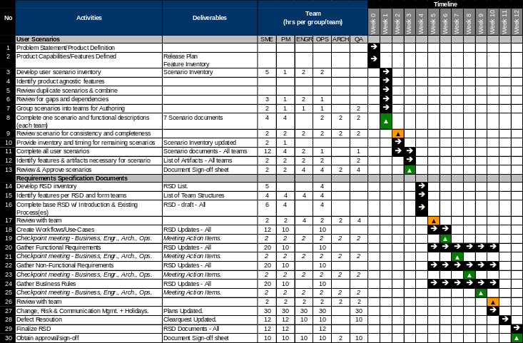
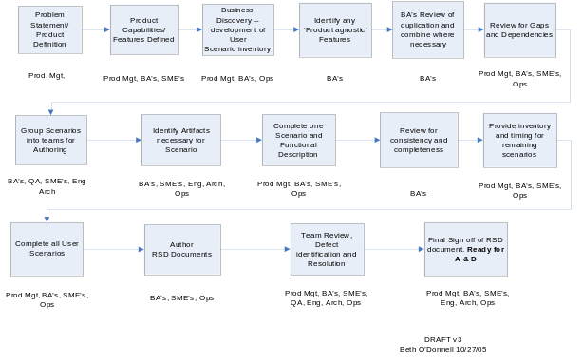
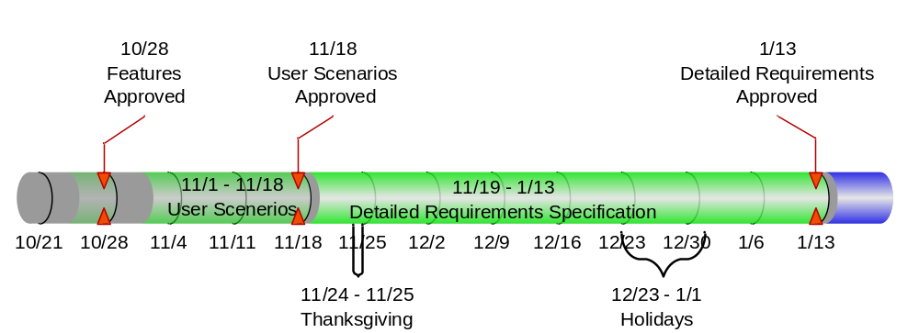
Requirements Development
The overall timeline
Detailed planning
is in progress
The condensed version:

Slide 6
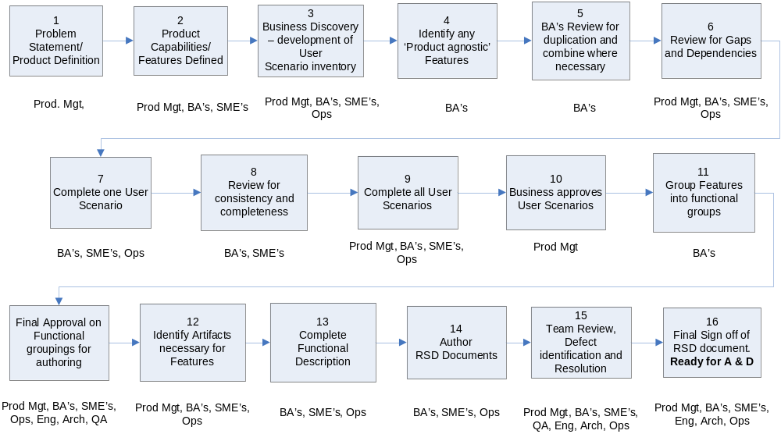

Requirements Process for MK Market Tracking Solution

Slide 7
Requirements Development
Open issues that will be resolved soon
(“We’re working on it…”)
  What change management process will be used?
  Who will cross-connect all of the requirements and how?
  (e.g., Who understands the totality of the system? How do we trace it all?)
  Review process for finding bugs; approval process.
  What will be the format/form of the final Requirements Specification Document (RSD)?
  How it will be assured that the RSD content is understood and agreed to by the Engineering & Operations groups?
Details and training later … Just in time.

Slide 8
User Scenarios – What are they?
Plain English that documents a common IRI understanding of the workflow that “actors” (clients and IRI Operations) will use to interact with the SMT features
Example of a brief User Scenario Summary:
Retailer merger/acquisition scenario: The sale of stores from one retailer to another requires that IRI change each retailer’s RMA geographies to reflect the change and provide SMT clients with these new geographies within agreed-upon SLA. These changes involve both the deletion and addition of RMA geographies in the client’s deliverables as well as changes related to differences in data release policy between the two retailers

Slide 9
Why User Scenarios?
Put the features and capabilities in context - provides the consumers of the detailed requirement with the “why?”
  For Architecture Team
  For Development
    IRI and Acxiom – local and offshore
  For QA / Testing
Provides those who will be changing requirements in the future with the means to evaluate the impact of those changes
  Requirements traced to user scenarios enables impact assessments to be performed
Facilitate the creation of the Requirements authoring teams
Drive the Identification of Non-Functional Requirements

Slide 10
User Scenario Identification
1st step – Identify the user scenarios – By Friday, November 4th
Directive:
  Teams will identify all scenarios associated with its capabilities group
  Teams will provide a summary of each identified user scenario
    A summary should be a short paragraph, 2 to 3 sentences, providing an overall description of the scenario and should include the actor(s)
  Teams will identify the effort required to develop each user scenario.
Purpose:
  To obtain a master list of the user scenarios associated with SMT
    Checked and reworked to remove overlap and eliminate gaps
  To estimate the required effort per team to create the user scenarios
In order to:
  Restructure the teams if necessary to include needed subject matter experts
  Reassign user scenarios to different teams if necessary to better align related scenarios within teams and to distribute the workload

Slide 11
6 Requirements Groups
Accuracy
Integration & Speed
Relevancy
Syndication/Flexibility
Impact Analysis & Communication
Content Redesign & Cleanup
* Non Functional Requirements

Slide 12
Teams for User Scenario Identification
Accuracy
  AR&D TBD
  Lisa Kerr
  Jonah Ellin
Integration & Speed
  Michael Cobb
  Don Dedic
  Frank Bolker
Relevancy
  Sheila Noojibail
  Waseem Azfal
  Mark Van Ommen
Flexibility/Syndication
  Katie Vandercar
  Sarah Azhar/Dan Nelson
  Maura McCarthy-Galligan
Impact Analysis & Communication
  Cathy Dalal
  Siva Purush
  Jen Thompson
Content Redesign & Cleanup
  Christy Henry
  Mike Leshchiner
  Vicki Hickey

Slide 13
Requirements Process –
Roles and Responsibilities for this first step – User Scenarios
Business Analyst
  Leads / Facilitates Business Analysis to Identify all scenarios by Capability Group
Lead Author
  Focus on the client interaction with the SMT features/capabilities
Operations Expert
  Focus on the interaction between IRI internal actors and the SMT features/capabilities
Others who will be involved in Requirements authoring once the user scenarios have been identified
  Subject Matter Experts
  Engineering
  Architecture
  Business Process
  Systems Analysts (Acxiom BA’s)

Slide 14
Identifying User Scenarios – Suggested Approach
Capability
Feature #1
Feature #2
Feature #3
Feature #4
Feature #5
Feature #6
Actor #1 - Retailer
Actor #2 – Manufacturer Client
Actor #3 – IRI Operations
The BA’s will take the lead in facilitating this process

Slide 15
Market Knowledge
Market Tracking Solution Requirements
Step Two
November 9th, 2005

Slide 16
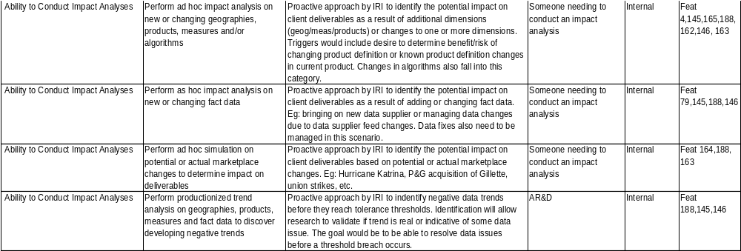
Scenario Inventory - Results
Approximately 60 Scenarios have been identified. For example:
47 identified by teams – additional 13 identified by Product Management

Slide 17
User Scenarios – Next Steps
1. Develop Detailed Scenarios from current Summaries
2. Each team has completed one detailed User Scenario (done 11/8)
3. “Standardization” exercise underway (complete 11/10 – AM)
Each BA is reviewing all other BA’s detailed Scenarios
Meet to standardize approach, level of detail, etc.
4. Add SME’s to the teams
5. Complete remaining Scenarios in agreed-upon format (11/16 - EOD)
6. Scenarios to be reviewed by Product Management, Architecture and Engineering
7. All Scenarios approved (Friday, 11/18)

Slide 18
Teams for User Scenario Completion
Accuracy
  Greg Hudak
  Scott Kelley
  Lisa Kerr
  Jonah Ellin
  Seza Tapban *
Integration & Speed
  Michael Cobb
  Don Dedic
  Frank Bolker
  Roger Failing
  Jeff Wallk *
Relevancy
  Sheila Noojibail
  Waseem Azfal
  Mark Van Ommen
  Cynthia Hlad
  Satish Gadiraju *
Flexibility/Syndication
  Katie Vandercar
  Sarah Azhar/Dan Nelson
  Maura McCarthy-Galligan
  Amy Tivilini
  Radha Yalawartha *
Impact Analysis & Communication
  Cathy Dalal
  Siva Purush
  Jen Thompson
  June Fenzel
  Darek Wiszniewski *
Content Redesign & Cleanup
  Christy Henry
  Mike Leshchiner
  Vicki Hickey
  Joan Crawshaw
  Jon Strauss
  Laura Frey *
* Denotes reviewer

Slide 19
Market Tracking Service – Requirements Next Steps (Next week)
After Completion of User Scenarios
1. Finalize Requirements Groups and Teams for Creation of requirements documents – by 11/18 for start following week
2. Review recommendations with PM, QA, Engineering, Architecture – 11/15
3. Finalize “Requirements Specification Document” – 11/16
- Format and components
- Guidelines for use
4. Train authoring teams (TBD – late next week)

Slide 20
DRAFT – Potential Requirements Team Realignment
From Business Focus to Engineering focus
Master Data
  Venue Dimension
  Product Dimension
  Releasability
  Measure Definitions
Transactional Data
  Order Entry and Fulfillment
  Job Scheduling
  Data Mart/Model Creation
  Application of Data Mods
  Selective Restatements
Customer Management
  Customer Profile and Hierarchy
  IRI Product Definition
  Enabling Product Configuration
  Contract management
  Sales Quote Process
Supplier Management
  Supplier Profile and Hierarchy
  Supplier Contract Management
  Supplier Data Receipt
  DCS
  Projection and Translation
  FDW Load and Maintenance
Recovery/Investigations
  DIV
  JETS
  MMS
  Supplier Data QC
  Client Deliverable QC
Integration
  All Interfaces within MK Factory Components
  All Interfaces to External Packages
  Security and Governance Integration across the factory
  Integration between SMT and other MK products

Slide 21
Questions?

